Slide 1
Deploy Three-Tier Architecture in
AWS using Terraform
devops

Slide 2
Terraform-Terraform is an open-source infrastructure-as-code software tool created by HashiCorp. Users define and provide data center infrastructure using a declarative configuration language known as HashiCorp
Terraform commands
Terraform init-initializes the current directory
Terraform refresh-refreshes the state file
Terraform validate-check whether the configuration is valid
Terraform plan-show changes required by current configuration
Terraform apply-create or update infrastructure
Terraform destroy-destroy previously-created infrastructure

Slide 3
Key features of terraform A console that allows user to observe functions The ability to translate HCL code into JSON format
Sign into the aws console and search ec2 instance
Click on launch instance and create a instance give the SSH security group and key pair.

Slide 4
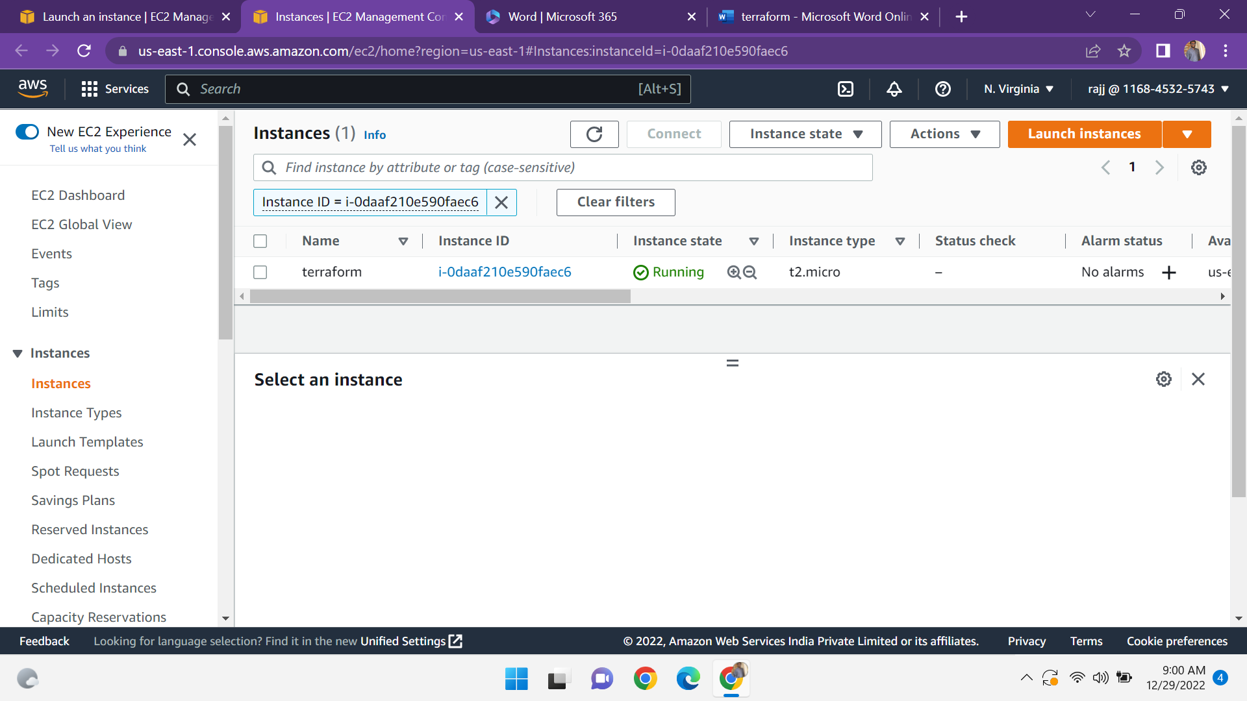

Slide 5
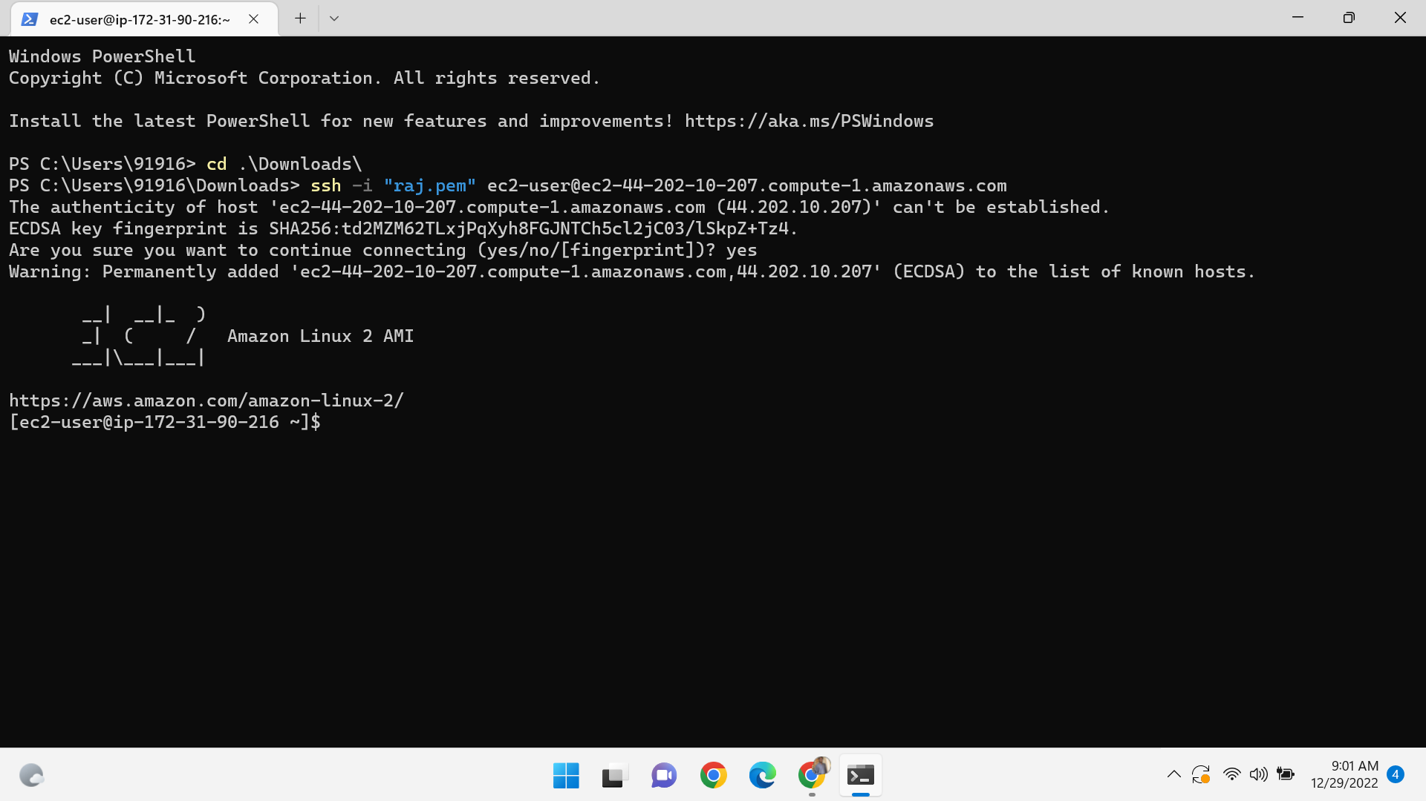
Connect the instance to the terminal

Slide 6
Install the terraform in terminal by using the following commands
Go to terraform website-install terraform in amazon linux
sudo yum install -y yum-utils shadow-utils
sudo yum-config-manager --add-repo https://rpm.releases.hashicorp.com/AmazonLinux/hashicorp.repo $
Sudo yum –y install terraform

Slide 7
In terminal create one directory by using command-
Mkdir terraform
Go to that directory cd terraform
Create a file in the directory-vi vpc.tf
Create a vpc and after create a subnets-vi subnet.tf
And after create a route tables and security groups-web_sg.tf and database_sg.tf
And then create a two ec2 instances by using the resource of above created security groups and subnet id .
Copy the public ip address on the browser

Slide 8
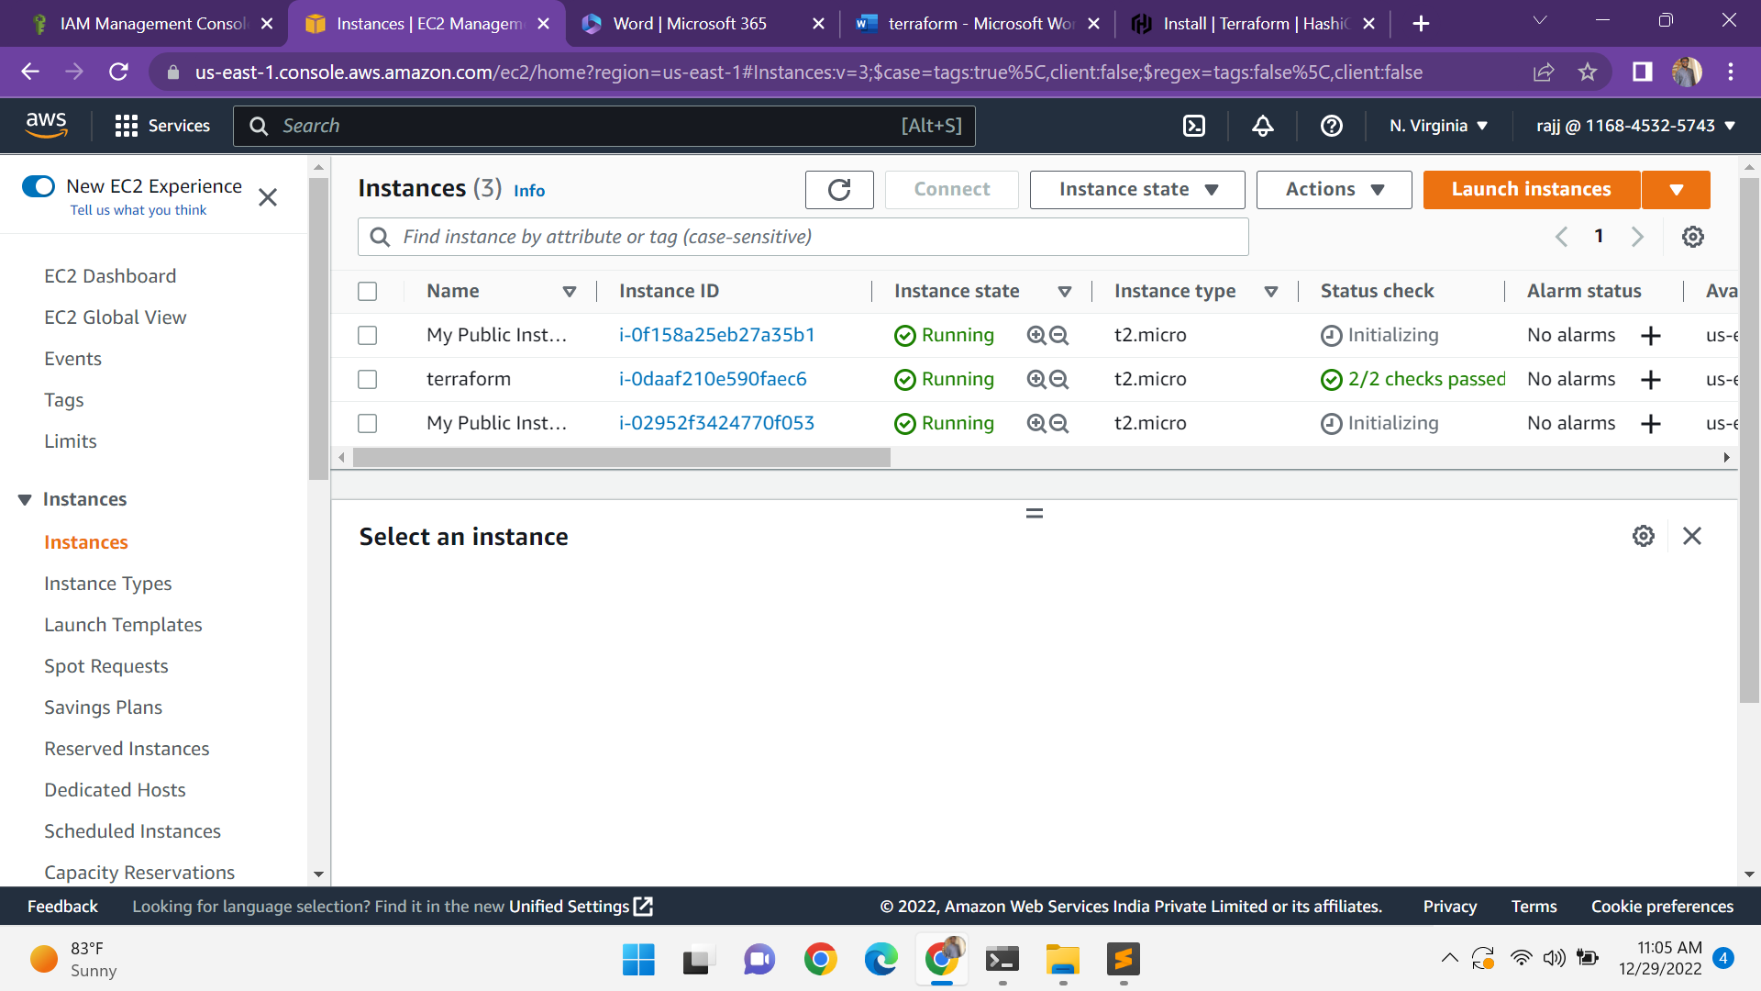

Slide 9
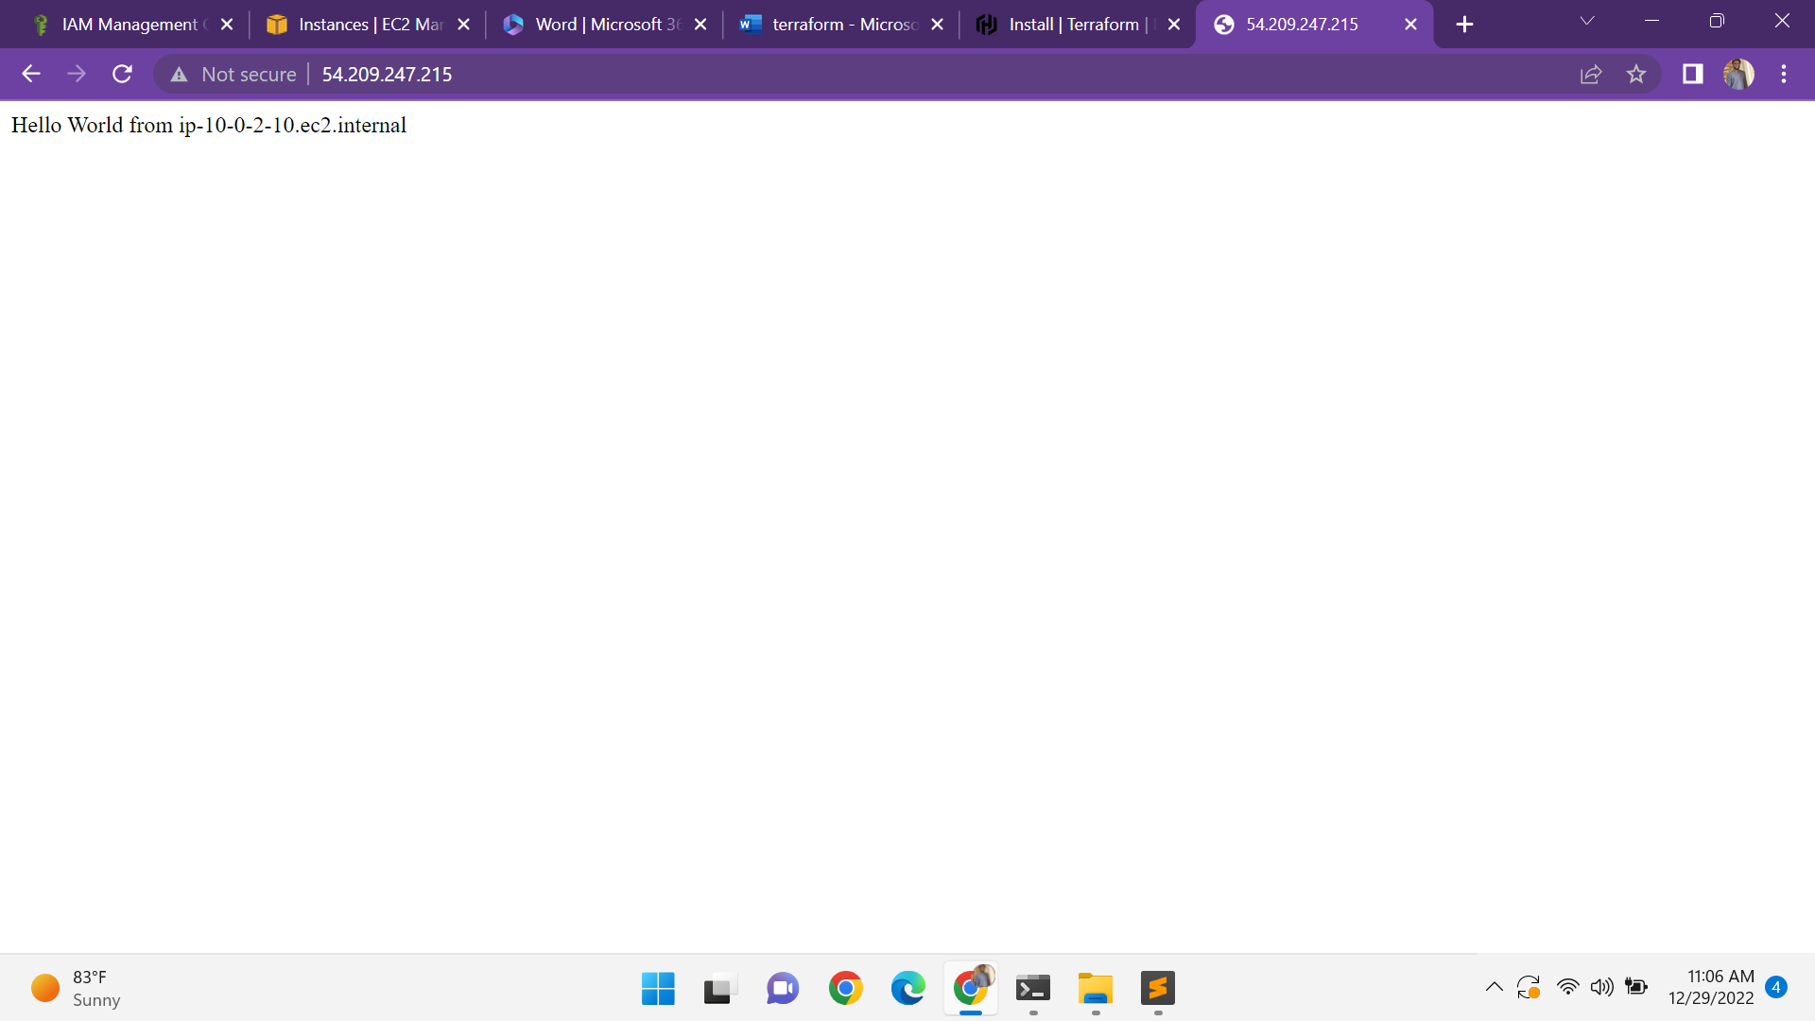

Slide 10
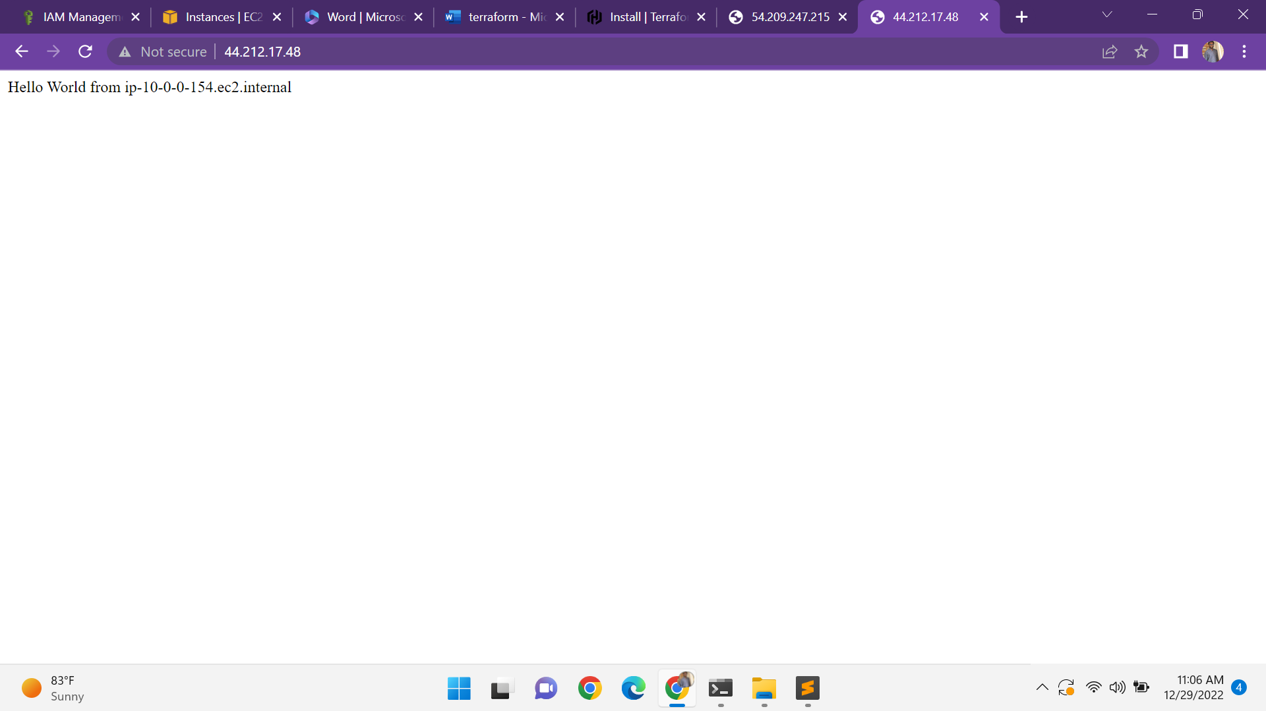

Slide 11
And after create an rds load balancers and shown the output
Create a repository in git hub push the files to your repo by using following commands
Git add
Git commit –m "xyz"
Git push remote origin <paste git repo address>

